Slide 1
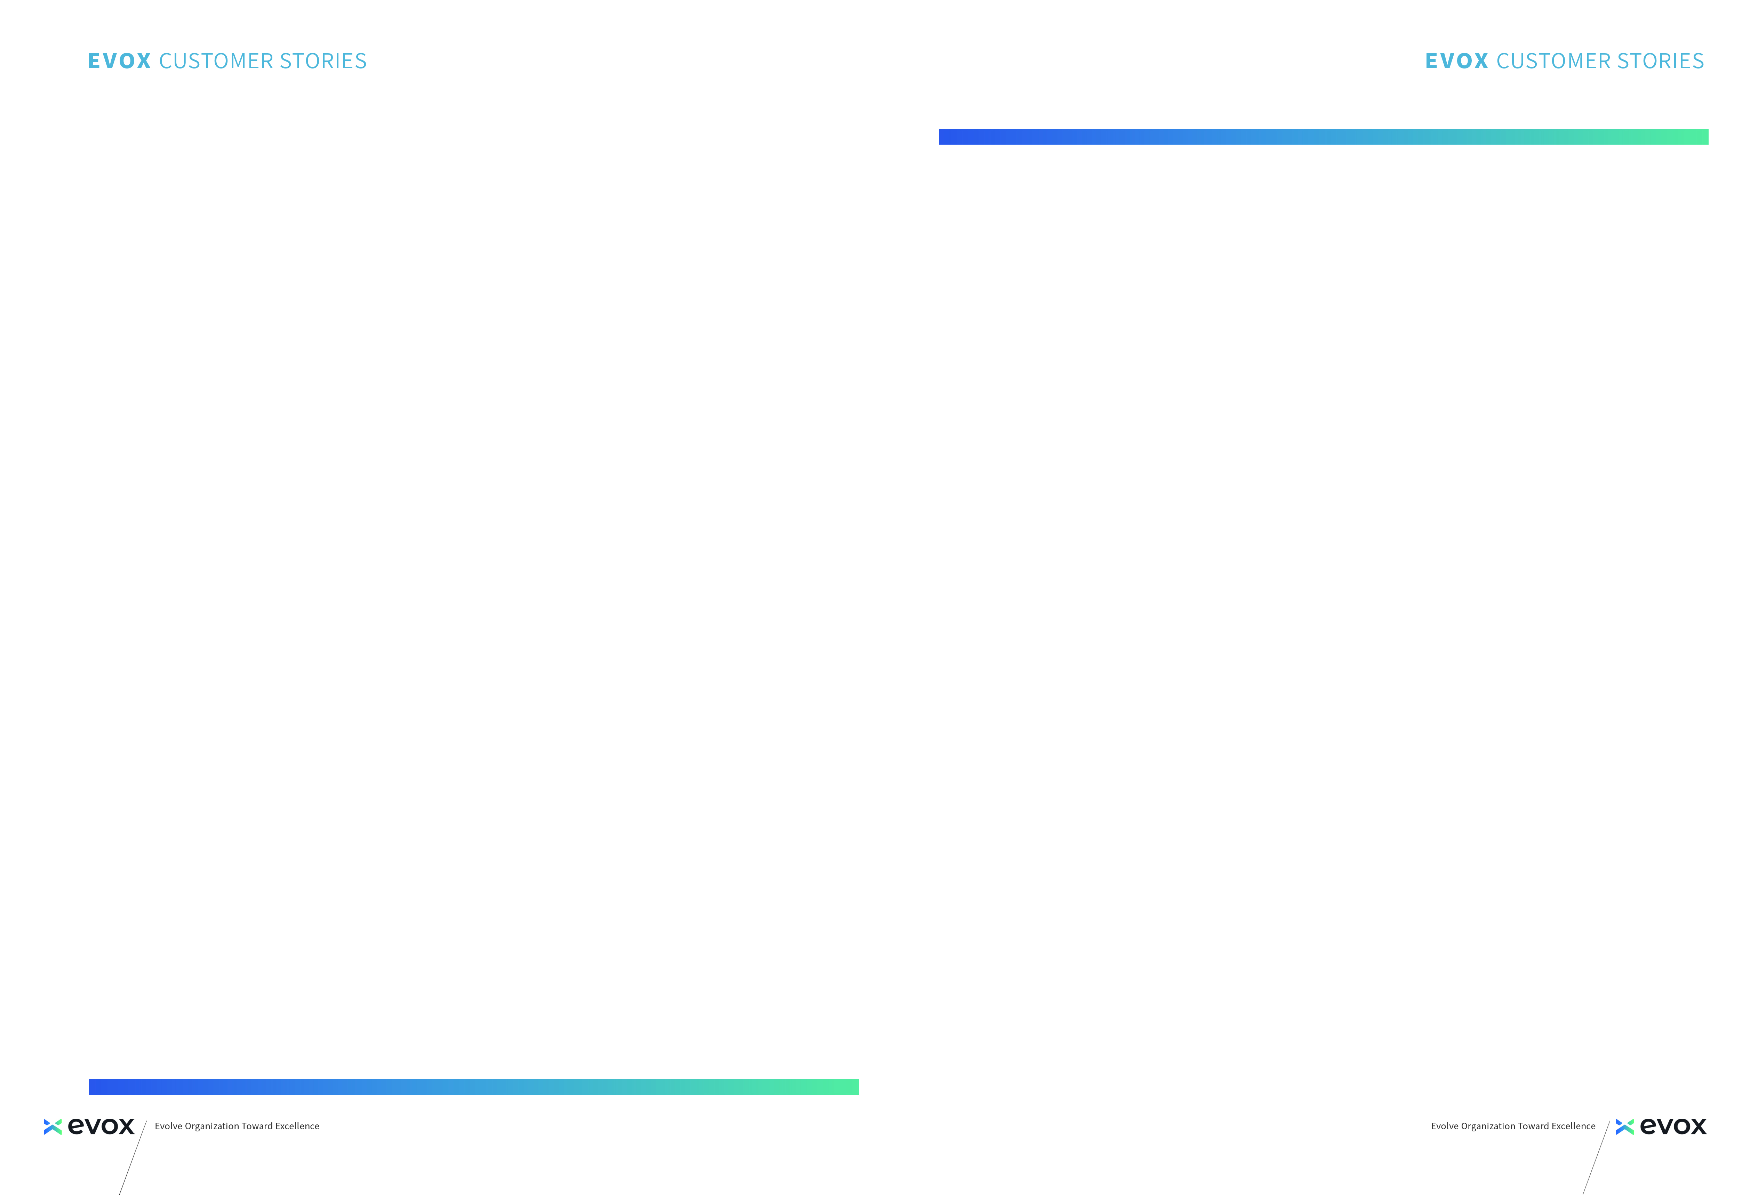
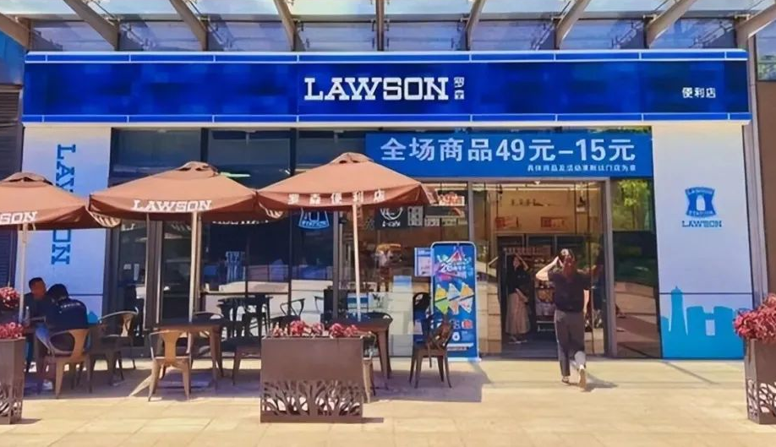
Retail
LAWSON Transforms Budgeting with EVOX:
Empowering Finance with Agility Across 6,300+ Stores
Customer Profile
LAWSON China, the largest overseas subsidiary of Japan’s LAWSON Inc., operates 6,300+ convenience stores nationwide. As a fast-growing leader in China’s retail sector, it is accelerating digital transformation to support rapid expansion and ambitious revenue growth.
Challenges
- Rapid business expansion required scalable and unified budgeting processes.
- Heavy reliance on manual operations hindered efficiency and transparency.
- Lack of real-time forecasting and integrated financial oversight.
EVOX Solution Highlights
- Centralized budgeting framework combining manual input and automated data integration.
- Multi-dimensional scenario planning aligning HQ strategy with store-level execution.
- End-to-end budgeting automation with version control and audit tracking.
- AI-powered forecasting for rapid analysis and adaptive planning.
Why EVOX?
EVOX enabled LAWSON China to break down silos between finance and operations, building an agile, insight-driven budgeting system that scales with growth—empowering decision-making across 6,300+ retail stores.
Benefits
95%: Process automation eliminated manual errors and significantly improve
operational efficiency.
60%: Reduction in budget cycle time accelerated both planning and execution.
360°: Comprehensive visibility into financial performance at both store and
regional levels.
3x Faster: Resource reallocation in response to market changes enabled quicker
business adjustments.

Slide 2
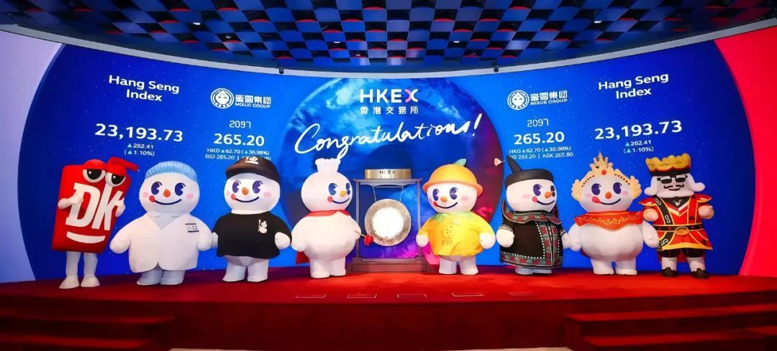
Retail
Mixue Ice Cream & Tea:
Global Food & Beverage Giant Driving Enterprise-Wide Strategic Alignments with EVOX Budgeting and Planning Solution
Customer Profile
Mixue Ice Cream & Tea (“Mixue”) is a fast-growing force in the global food and beverage market, operating a fully integrated value chain， from product innovation and large-scale production to worldwide logistics, sales, and thousands of retail outlets.
Challenges
- Decentralized Budgeting: Different practices across six business units made unified budget control difficult.
- Manual & Low-Granularity Processes: Sales budgets lacked detail; production budgeting relied on manual, complex workflows, making planning time-consuming.
- Intercompany Complexity: Multiple internal transactions created heavy consolidation and elimination workloads.
EVOX Solution Highlights
- Consolidated Framework: Established group- and unit-level budget centers to enhance collaboration and synergy.
- Refined Budgeting: Shifted to driver-based models with detailed sales (by region, channel, SKU) and production budgeting linked to BOM and consumption data.
- AI-Driven Forecasting: Improved forecast accuracy to 98%, halved planning time, and enabled dynamic scenario planning.
Why EVOX?
Mixue chose EVOX for its powerful budgeting capabilities, proven implementation expertise, and track record in serving large-scale chain enterprises, enabling efficient financial control during global expansion.
Benefits
Efficiency & Automation: Centralized data and automation cut planning cycles
from months to days, shifting from manual handling to insight-driven decisions.
Accuracy & Trust: Integrated model boosts forecast reliability, KPI tracking, and predictive financial modeling.
Collaboration & Alignment: EVOX links departments, integrates systems, and aligns budgeting with strategic goals.
Granularity & Control: Flexible planning across SKUs, stores, and departments with multiple budgeting approaches.

Slide 3

Food & Beverage
Wei Chuan × EVOX Comprehensive Budget
Management Optimization Project
Customer Profile
Established in 2002, Wei Chuan Group Foods is a leading Taiwanese dairy firm. Its 2018 revenue topped NT$4 billion, offering hundreds of refrigerated products (lactic acid bacteria drinks, juices, milk) under a "sales-driven, zero-inventory" model with full cold chain for freshness.
Challenges
- Slow budgeting: Next year’s budget takes 2-3 months, highly time-consuming.
- Data asynchronization: Rapid business changes hinder budget-actual comparison.
- Incomplete system: Budget misaligned with strategy, overly finance-focused.
- Heavy workload: Numerous SKUs, complex costs; 130-person team repeats trial calculations.
EVOX Solution Highlights
- Flexible production-sales balance: Configurable tables enable "sales-driven production" – no IT reliance.
- SKU-level costing: ABC + system algorithms for granular per-SKU costs.
- Process & permission control: Defined roles, standardized workflows; HQ real-time progress tracking.
- Multi-dimensional analysis: Channel/region/SKU drill-down for rapid data retrieval.
- Business-finance integration: Unified platform for real-time data sharing.
Why EVOX?
EVOX breaks business-finance data silos, enables SKU-level granular budget management, resolves issues like lengthy budgeting and data asynchronization via flexible production-sales balance and multi-dimensional analysis, and provides real-time data support for corporate decision-making.
Benefits
Higher Budgeting Efficiency: Streamlined processes and unrestricted access cut cycle time.
Lower Labor Costs: Automated data integration reduces manual and repetitive work.
Financial Role Transformation: Shift from basic tasks to high-value data analysis.
More Accurate Decision-making: Multi-dimensional analysis delivers comprehensive business insights and data support.

Slide 4
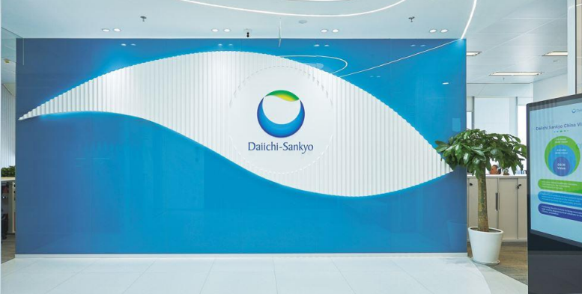
Pharmaceutical
How EVOX Helped Daiichi Sankyo
Cut Forecasting Effort by 70% and Save $2.1M
Customer Profile
Daiichi Sankyo is Japan’s No.2 pharmaceutical company. Its China headquarter in Shanghai oversees 18 subsidiaries and 1,500+ staff, driving innovation in oncology, cardiovascular, and anti-infective therapies as part of its Vision 2030 strategy.
Challenges
- Frequent policy shifts and market volatility increased complexity in budgeting and planning.
- Fragmented data led to manual reconciliations, delaying decisions by 30–45 days per quarter.
- Quarterly rolling forecasts required 500+ person-hours monthly, straining R&D focus.
- Legacy systems lacked multi-dimensional reporting, making dual compliance costly.
- Manual allocation of $150M+ intercompany charges delayed closing across 20+ entities.
EVOX Solution Highlights
- Agile budgeting framework with 12+ scenario models aligned to real-time policy and KPI shifts.
- ISO 8000-compliant master data with automated cross-department validation
- AI-powered forecasting cut quarterly rolling forecast efforts by 70%.
- Self-service multi-dimensional reporting for dual compliance across products, regions, and therapeutic areas.
- Automated intercompany reconciliation resolved 95% of disputes pre-close with unified P&L views.
Why EVOX?
EVOX enabled Daiichi Sankyo China to overcome data fragmentation, regulatory complexity, and resource-heavy processes. By integrating predictive analytics, automated reconciliations, and scenario planning, the platform helped unify finance operations across 18 subsidiaries, reduce risks, and unlock greater agility to support the company’s growth in China’s $140B oncology market.
Benefits
45%: Faster budget cycles enabled rapid responses to NMPA regulatory changes.
99.2%: Data accuracy achieved across financial statements through automation and controls.
$2.1M: Annual savings from reduced manual reconciliation and reporting efforts.
360°: Profitability insights enabled 15% oncology portfolio optimization.
30% Faster: Month-end close cycle, ensuring timely compliance with CSRC and J-GAAP.

Slide 5

Auto & Parts
Chery’s Success with EVOX SPM:
Revolutionizing Automotive Incentive Management:
Customer Profile
As a leader in the automotive sector, Chery Automobile continues to drive innovation and operational excellence. Its new sales rebate program strengthens dealer partnerships and supports long-term growth amid rising competition.
Challenges
- Over 10 million data points and RMB 1B+ fund flows created major processing complexity.
- Multi-brand, multi-policy structures made rebate management rigid and error-prone.
- Manual workflows introduced audit risks and delayed operations.
- Fragmented approvals led to bottlenecks and slow decision-making.
- Fragmented approvals led to bottlenecks and slow decision-making.
- Limited analytics capabilities blocked data-driven growth opportunities.
EVOX Solution Highlights
- Tiered policy templates enabled fast, scalable rebate configuration across brands and regions.
- Centralized data warehouse delivered real-time insights and trusted governance.
- T+1 automated settlement mechanism accelerated fund turnover and efficiency.
- End-to-end digitalization replaced manual tasks with fully automated, auditable workflows.
- AI-driven analytics enabled deep visibility into sales, inventory, and incentive impact.
Why EVOX?
EVOX enabled Chery to transform its sales rebate program from a fragmented, manual process into a real-time, intelligent engine for growth.
Benefits
94% Faster Rebate Processing: accelerated end-to-end rebate cycle times through streamlined digital workflows
360° Dealer Visibility: Real-time rebate tracking portal reduced disputes by 65%
30%: Efficiency improvement in working capital
50+ KPIs at a Glance: The platform centralized critical data, enabling smarter,
data-driven business decisions.

Slide 6
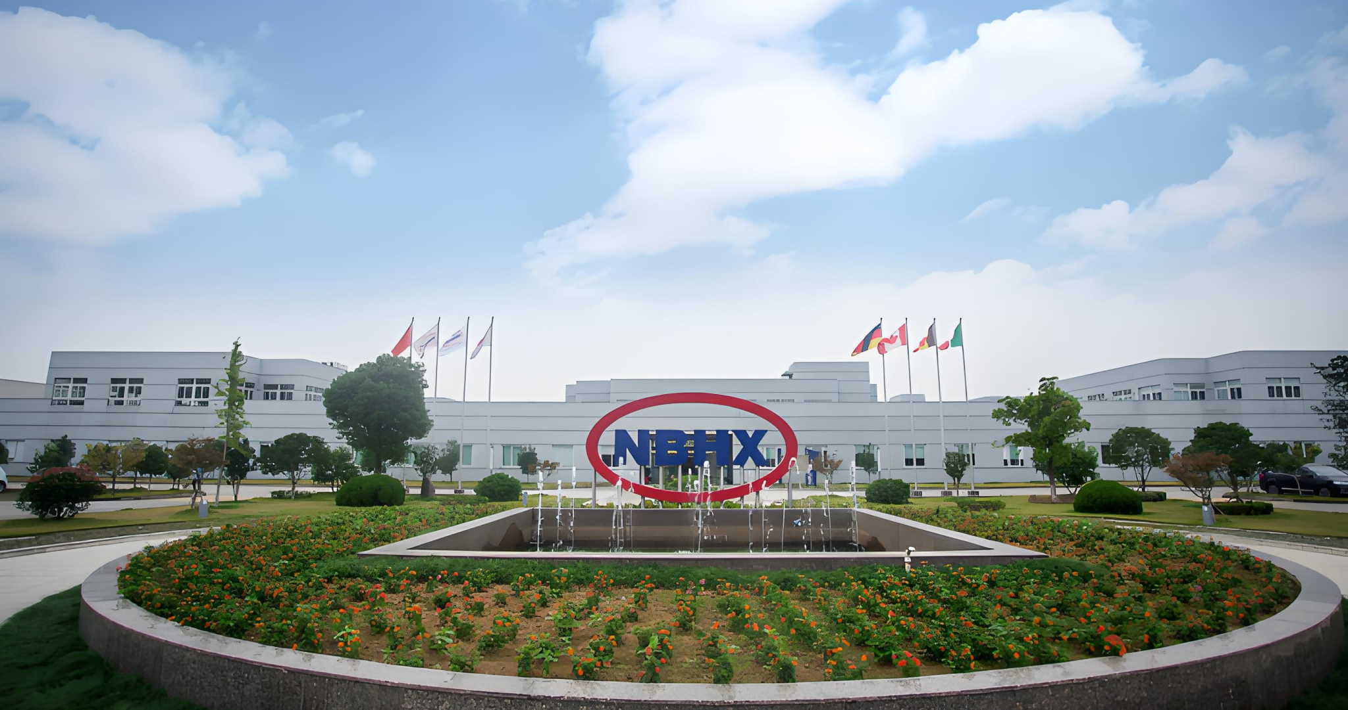
Auto & Parts
Ningbo Huaxiang:
Accelerating Budget Digitalization with EVOX
Customer Profile
Ningbo Huaxiang is a large manufacturing group with over RMB 30 billion in annual revenue, 70+ subsidiaries, and a product matrix of over 200,000 SKUs across automotive parts, electronics, and new materials.
Challenges
- The group operated multiple systems (SAP, Yongyou, etc.), leading to fragmented data and inconsistent standards, making budgeting inefficient and cumbersome.
- Excel and email-based collaboration were error-prone, version control poor, permission management weak, and traceability difficult.
- The finance team took an average of two days to handle budgeting for a single subsidiary, severely hampering decision-making speed.
EVOX Solution Highlights
- EVOX automated data extraction, cleansing, and unified storage across systems, eliminating data silos.
- A 3D modeling engine spanned strategy, operations, and finance, enabling intelligent budgeting.
- A centralized data dictionary, automated validation rules, and permission partitioning ensured standardization and secure workflows.
- Machine learning and a visual management cockpit enhanced forecasting accuracy and enabled real-time decision support.
WhyEVOX?
EVOX’s comprehensive budgeting solution, featuring 3D modeling, intelligent validation, and a visual cockpit, effectively addressed Huaxiang’s pain points of inefficient budgeting, fragmented data, and slow decision-making, empowering rapid digitalization of budgeting and strategic execution.
Benefits
80% Efficiency Boost: Budget cycle shortened from 2 days → 0.4 days.
65% Reduction: Overall finance workload significantly decreased.
83% Faster Reporting: Decision reporting accelerated, driving 40% stronger market response agility.
91% Data Integration: Business-finance integration improved from 58% → 91%, with 98% cost tracking accuracy.
±3% Forecast Deviation: Strategic alignment reached 89%, achieving a closed-loop budget management cycle.

Slide 7

Real Estate
Jinjiang GPP Boosts Efficiency with EVOX:
From Manual Chaos to Automated Precision
Customer Profile
Jin Jiang International (Holdings) Co., Ltd. is a Asia leading tourism and hospitality company, managing 382 hotels and resorts in 10 countries in North America, Europe and Asia.
Challenges
- Policy updates were slow and inflexible, requiring IT support and delaying responsiveness.
- Manual commission calculations led to frequent errors and unreliable financial data.
- Lack of audit trails in adjustments exposed the business to compliance risks.
- Manual reconciliation processes caused long billing cycles and strained cash flow.
EVOX Solution Highlights
- Intelligent policy builder enables fast, no-code configuration with full audit traceability.
- Automated engine handles complex rebate logic and special contract conditions seamlessly.
- Real-time dashboards give suppliers clear visibility into commissions, payments, and disputes.
- AI-powered reconciliation reduces billing errors and speeds up cash collection.
Why EVOX?
EVOX enabled Jinjiang GPP to eliminate manual bottlenecks, reduce compliance risks, and streamline complex commission structures across 2,000+ suppliers. By introducing no-code policy configuration, ERP-integrated automation, and real-time supplier portals, the platform helped accelerate billing cycles, enhance financial transparency, and establish a scalable foundation for digital procurement excellence in China’s multi-billion-dollar hospitality industry.
Benefits
98% Policy Configuration Agility: Educed setup time from 5 days to just 4 hours
89% Reduction in Billing Errors: Achieved through AI-powered cash application
40% Faster Collections: Driven by automated reconciliation workflows
23% Fewer Commission Errors: By eliminating manual calculations
Billing Cycle Shortened from 15 Days: Improving cash flow and supplier satisfaction

Slide 8

Banking
Accelerating Financial Close and Compliance:
How Bank of Shanghai Leads with EVOX
Customer Profile
Bank of Shanghai is a trusted premier bank focused on service excellence and fintech innovation. In response to 2023 regulatory guidelines, it is modernizing legacy systems to boost agility, ensure compliance, and enhance strategic decision-making.
Challenges
- Disconnected workflows delayed financial close and increased compliance risk.
- Inconsistent reporting across entities compromised data accuracy and integrity.
- Legacy tools lacked scalability to support rapid growth and regulatory demands.
EVOX Solution Highlights
- Automated multi-level aggregation and intercompany reconciliation.
- Standardized reporting frameworks aligned all entities under unified governance.
- Real-time performance dashboards enabled “one-click” consolidated statements and faster decisions.
Why EVOX?
EVOX enabled Bank of Shanghai to move beyond fragmented, manual reporting and build a unified, intelligent financial architecture. With built-in auditability, scalable reporting frameworks, and AI-driven analytics, EVOX Consolidation positioned the bank for regulatory agility, faster close cycles, and insight-driven group leadership—ushering in a new era of digital finance.
Benefits
30%+ Faster Close: Driven by fully digitized consolidation workflows
Real-time Group-level Reporting: Enabled by one-click consolidated statements
Unified GAAP/IFRS Compliance: Through redesigned dimensional hierarchies and
disclosure models
Embedded Audit Trails: Ensured traceability and full regulatory alignment
Instant Statutory and Management Views: WiIth a single reporting architecture

Slide 9
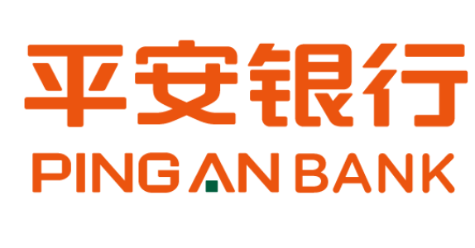
S
Banking
EVOX Empowers Ping An Bank:
Enhancing Budget Efficiency and Strategic Alignment
Customer Profile
Founded in 1987 (Shenzhen HQ), Ping An Bank is a joint-stock commercial bank with nearly RMB 5 trillion in assets and over RMB 150 billion in annual revenue. Evolving markets and regulations raised its demands for budgeting, forecasting, and data management.
Challenges
- Traditional branch-by-branch reporting resulted in low data granularity and inefficiency.
- Data collection relied on manual inputs, Excel, and email, leading to poor accuracy and weak
traceability.
- Long budgeting and forecasting cycles delayed strategy execution and decision-making.
- Increasing regulatory and disclosure requirements made budgeting and reporting more complex.
EVOX Solution Highlights
- Established a unified budgeting, forecasting, and reporting framework across headquarters and branches, enabling real-time data collection and sharing.
- Applied intelligent forecasting models covering revenue, cost, risk, and non-interest income.
- Built a centralized reporting platform to support multi-version and multi-scenario budgeting and rolling forecasts.
- Implemented data quality monitoring and validation mechanisms to ensure accuracy and compliance.
Why EVOX?
Ping An Bank chose EVOX for its proven expertise in the financial sector, flexible and scalable modeling capabilities, and end-to-end digital support. EVOX not only met the bank’s needs for refined budgeting and forecasting but also ensured efficiency and transparency under complex compliance and regulatory requirements.
Benefits
50% Reporting Efficiency Gain: Streamlined processes for faster insights.
Smart Forecasting: AI-based models enabled non-interest income prediction, greatly improving accuracy.
Business Value Creation: Built an end-to-end budgeting and forecasting system, enabling faster responses to market and regulatory changes.
Compliance Assurance: End-to-end data traceability ensured strict compliance with regulatory and audit requirements.

Slide 10
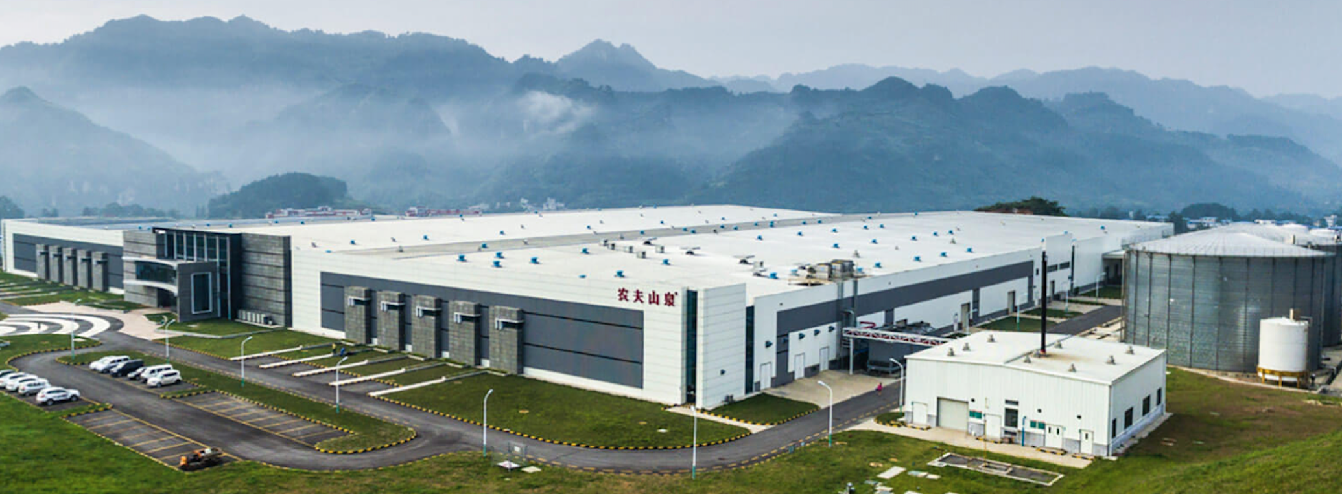
Food & Beverage
Nongfu Spring:
Achieving FP&A Excellence in FMGC with EVOX
Customer Profile
A leading player in the beverages Fast-Moving Consumer Goods (FMCG) industry. Operates with a complex production management model, involving 1000 users and nearly a thousand products/raw materials.
Challenges
- Error-Prone & Lacking Granularity: Manual compilation caused errors and limited multi-dimensional analysis.
- High Workload & Inefficiency: Repetitive manual aggregationunder tight deadlines reduced efficiency.
- Lack of Real-time Monitoring: Complex, bottom-up processes made tracking and reminders impossible.
- Data Discrepancies: Inconsistencies existed between business and financial data.
- Manual Production Costing: Key production costs relied on manual entry, lacking automation and standardization.
EVOX Solution Highlights
- Integrated Budget Models: Covers sales, production, procurement, inventory, headcount, costs, taxes, and financial statements.
- Automated Costing: Calculates energy and raw material costs and allocates equipment expenses automatically, replacing manual entry.
- Streamlined Budgeting & Forecasting: Online submission with automated calculations and rolling forecast generation improves efficiency.
- Seamless Integration: Connects with SAP, CRM, Procurement, Expense Control, OA, and Enterprise WeChat to enable budget vs. actual analysis and execution tracking.
- Automated Workflow: Streamlines budget submission, approval, and reporting, with final data automatically consolidated into financial and analysis reports.
Benefits
From 2 Months to 3 Weeks: Automated calculations replaced manual work, boosting accuracy and efficiency.
Granularity Beyond Excel: Company-wide participation with detail down to customer, SKU, product, channel, and sales office.
Multi-Dimensional Insights: Income statements by product, category, channel, and region.
Closed-Loop Integration: Linked with SAP & other systems, driving continuous business optimization.

Slide 11
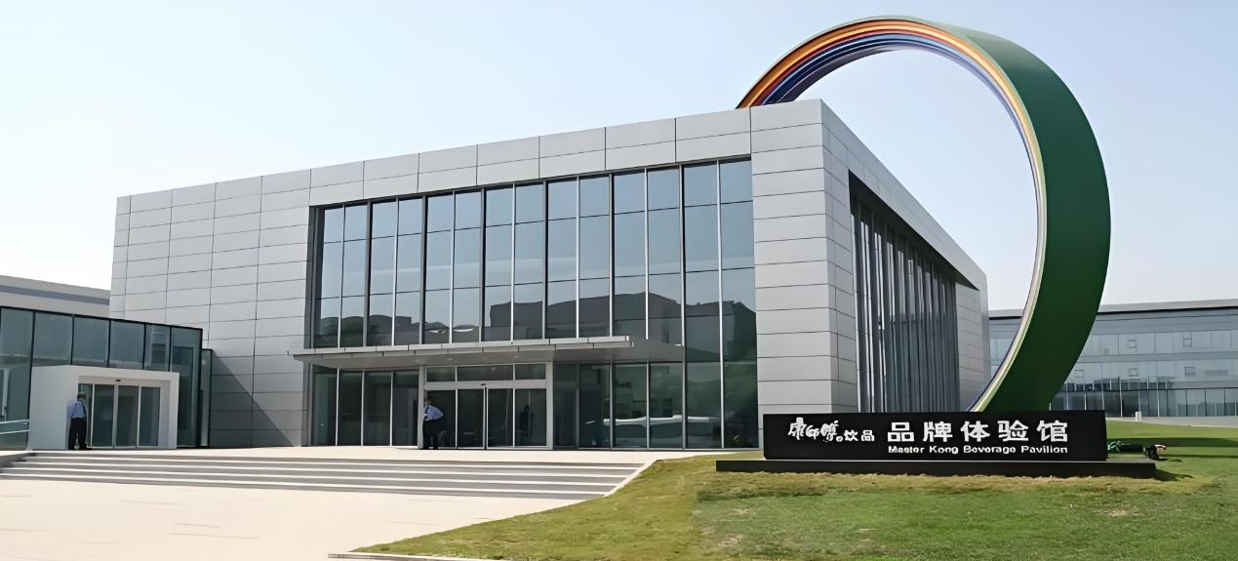
Food & Beverage
Master Kong’s Comprehensive Budgeting Transformation Journey
Customer Profile
Master Kong Beverage, a major arm of Master Kong Holdings, operates 100+ legal entities and 2,000+ sales units across 6,000+ nationwide channels. As the business scaled, growing complexity made it increasingly difficult to maintain efficient, accurate, and centralized budget control.
Challenges
- Complex, manual budgeting across 6,000+ SKUs and 10 billion+ records.
- Time-consuming annual planning and consolidation cycles.
- Lack of scenario modeling and centralized data governance.
EVOX Solution Highlights
- 3-Year Scenario Forecasting & Rolling Forecasts
- Multi-Dimensional Budget Analytics
- Seamless integration with SAP and real-time data sources
Why EVOX?
EVOX helped Master Kong transform its budgeting, analytics, and financial agility, empowering data-driven decisions and growth at scale.
Benefits
Budget Cycle Reduced from 1 Month to under 1 Week: accelerating planning
responsiveness and lowering costs
Closed-loop Governance from Planning to Performance Tracking: improving
alignment, traceability, and execution control
Profitability Analysis Down to SKU and Channel Level: enabling precision in
resource allocation and strategic decisions

Slide 12
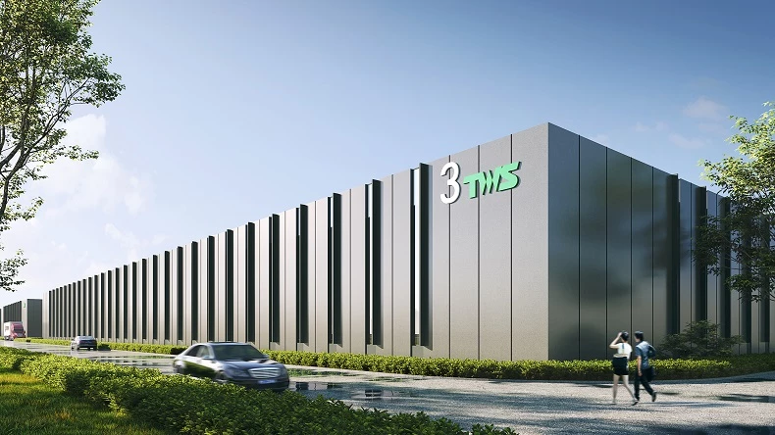
New Energy
Mingmei Building a Future-Ready Consolidated Reporting System with EVOX
Customer Profile
Mingmei New Energy is a global leader in customized lithium-ion battery solutions, with 2,500+ employees and six R&D centers across China, Japan, South Korea, Europe, and the U.S., driving innovation in smart energy systems and electrification.
Challenges
- Master data across systems was fragmented and hard to reconcile.
- Currency and ledger standards varied, impacting reporting accuracy.
- Manual reconciliation delayed intercompany close and transparency.
- Equity and internal eliminations were time-consuming and inconsistent.
- Financial analysis lacked granularity across regions and teams.
EVOX Solution Highlights
- Seamlessly connects automated and manual data across ERP, CRM, and other systems
- Instantly identifies and visualizes transactional mismatches in real time
- Streamlines equity, intercompany, and inventory adjustments with override flexibility
- Enables dynamic reporting by sales, region, and production unit
- Ensures compliance and audit-readiness through secure access and workflows
Why EVOX?
EVOX offered Mingmei a tailored consolidation platform that could seamlessly scale with its global growth. With intelligent reconciliation, rule-based automation, and dynamic analytics, EVOX empowered Mingmei to modernize financial governance while enabling real-time strategic control across entities.
Benefits
- 40% Faster Consolidation Cycles: Automated workflows reduced manual
interventions, accelerating month-end closes.
- 95%+ Data Accuracy: Standardized accounting rules and elimination logic enhanced
reporting integrity.
- 360° Transaction Visibility: Real-time intercompany transparency eliminated
reconciliation delays.
- Scalable Decision Intelligence: On-demand analytics empowered cross-functional
resource optimization

Slide 13
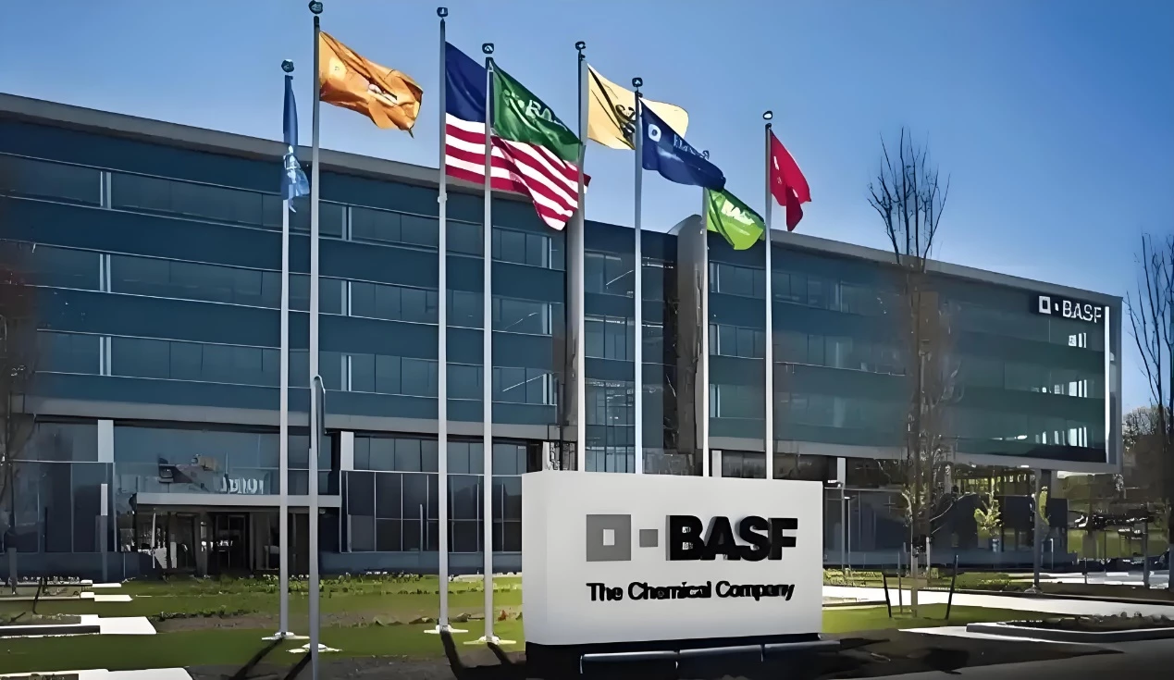
Chemical
BASF’s Financial Transformation:
Unlocking Agility and Precision with EVOX
Customer Profile
As a global chemical leader, BASF runs decentralized, multi-tiered operations across regions and functions from sourcing to sales. This complexity demands high accuracy, agility, and control in managing enterprise-wide budgets.
Challenges
- Limited data traceability in legacy systems obscured budget origins and decision logic.
- Manual, error-prone budgeting processes caused inefficiency and resource drain.
- Inflexible planning tools restricted scenario simulation and historical comparisons.
- Lack of integration between SAP and legacy tools created data silos and bottlenecks.
EVOX Solution Highlights
- Unified Budget Architecture: Standardized models and templates ensured global consistency.
- Automated Rule Engine: Predefined logic reduced manual work and improved data accuracy.
- Intelligent Collaboration: Real-time, rule-based workflows enhanced agility and alignment.
- Process Standardization: A clear budgeting calendar ensured timely, compliant execution.
- SAP Integration: Seamless connection eliminated silos and enabled real-time visibility.
Why EVOX?
BASF adopted the EVOX platform to replace inefficient legacy tools and meet the growing demands of modern budgeting. EVOX offers a unified, automated, and flexible solution that enhances data integrity, enables real-time collaboration, and integrates seamlessly with SAP. This empowers BASF to manage complexity with greater speed, accuracy, and strategic agility across its global operations.
Benefits
80%+ Efficiency Gain: intelligent automation significantly reduced manual effort and accelerated the budgeting cycle, driving operational efficiency
Enhanced Data Integrity: Standardized rules and transparent logic ensured greater
accuracy, consistency, and confidence in budgeting outcomes
Decision Agility: Real-time scenario modeling and version control improved
transparency in budget adjustments
System Synergy: Seamless SAP integration unlocked the data flow across platforms,
fostering enterprise-wide planning alignment

Slide 14
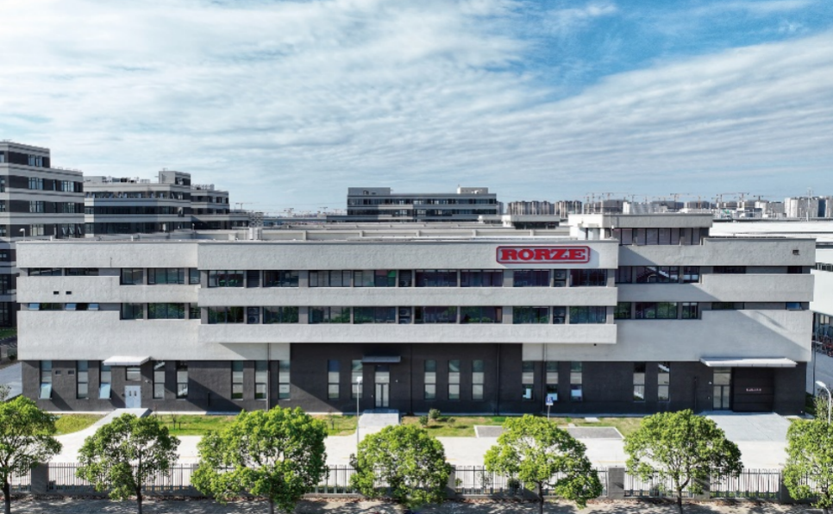
Manufacturing
Rorze Transforms Planning and Performance Management with EVOX
Customer Profile
RORZE, a global leader in semiconductor and panel display automation systems, has a Shanghai subsidiary handling local manufacturing, sales and services. It quickly meets Chinese customers’ needs to drive digital upgrading of manufacturing processes.
Challenges
- Dispersed budgeting process lacking a unified platform, making data integration difficult
- High communication costs between departments, with long budgeting and approval cycles
- Budgets not dynamically linked to strategic goals, making it hard to support timely decision-making
- Management unable to access multi-dimensional business data in real time, lacking intuitive visualization tools
EVOX Solution Highlights
- Connect budget preparation, adjustment, and execution to eliminate silos
- Build flexible data models tailored to financial and business needs
- Provide real-time dashboards and variance analysis for performance monitoring
- Streamline workflows with automation and reduce communication costs
- Use AI-driven forecasting and simulation to guide trends and decisions
Why EVOX?
Rorze chose EVOX for its proven expertise in budget and performance management, flexible customization, and advanced architecture that integrates seamlessly with existing systems. Unlike traditional solutions, EVOX provides real-time reporting and intelligent forecasting, enhancing strategic execution and decision-making while accelerating enterprise growth.
Benefits
Faster Budgeting Cycles: Reduced budget preparation time by 40%, significantly improving efficiency.
Higher Data Integration: Achieved 95%+ real-time integration of financial and operational data.
Improved Collaboration: Increased cross-departmental efficiency by 50%, with smoother approvals and adjustments.
Real-time KPI Monitoring: Enabled executives to track over 100 key performance indicators through dashboards.

Slide 15

Manufacturing
SANY: Establishing an Agile and Efficient Cost Control and Budget Management System with EVOX
Customer Profile
Sany, a global leader in construction machinery (pump trucks, road machinery, port machinery, mining machinery), opted for EVOX to pursue budget management reform amid expanded scale and refined management needs.
Challenges
- Inconsistent budget preparation across divisions caused misaligned standards.
- Disconnected reimbursement systems blocked smooth data flow.
- Poor alignment between applications and reimbursements lacked unified rules.
- Managing 50,000+ global employees brought heavy validation demands and multilingual complexity.
EVOX Solution Highlights
- Establish a budget preparation model covering 12 dimensions and over 300 indicators, and achieve uniform preparation standards.
- Establish a unified cost control center for the entire group, forming a closed-loop management process of planning, adjustment, implementation, analysis.
- Deeply integrated with ERP, business travel and expense management platforms, achieving real-time linkage between budget and business operations.
Why EVOX?
EVOX’s control center perfectly addressed SANY’s budgeting challenges while supporting its smart manufacturing and global growth. With a unified engine, flexible strategies, and strong integration, EVOX enabled efficient, refined management and laid the foundation for future innovation in the era of 5G, AI, and big data.
Benefits
Efficiency Improvement: Digitalized and intelligent budget management significantly enhanced operational efficiency and cost control.
Industry Benchmark: As an early adopter of the EVOX Planning System, Sany set a benchmark for digital transformation in construction machinery, attracting industry peers to learn from its success.
Smart Integration: Deeply integrated with Sany’s intelligent manufacturing, providing end-to-end data support from order to delivery and strengthening global competitiveness.

Slide 16
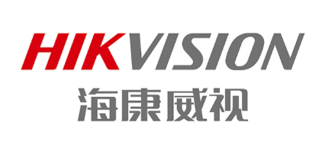
Hign Tech
EVOX Empowers Hikvision:
Financial Budget Optimization and System Upgrade
Customer Profile
Hikvision is a global leader in IoT solutions with video as its core competency, providing products and solutions for security, smart homes, industrial automation, and automotive electronics.
Challenges
- Budget management complexity increased due to global business expansion.
- Existing system lacked flexibility for multi-level budget control.
- Long budgeting cycle and difficulty in data integration.
- Insufficient linkage between financial planning and strategic goals.
EVOX Solution Highlights
EVOX implemented the second phase of Hikvision’s financial budgeting project, upgrading the budgeting system with:
- Centralized and intelligent budgeting platform.
- Scenario-based planning and rolling forecasts.
- Strengthened data integration between business and finance.
- Enhanced visualization for budget monitoring and control.
Why EVOX?
Hikvision chose EVOX because of its extensive expertise in enterprise-level budgeting projects and its deep understanding of the financial management needs of large organizations. EVOX’s ability to integrate budgeting with strategic management, combined with agile delivery model, ensured that Hikvision could achieve both efficiency and flexibility. In addition, EVOX’s proven reputation and commitment to long-term client partnerships gave Hikvision the confidence to select as a trusted partner.
Benefits
Centralized Management: Unified budgeting and performance platform reduces complexity and fragmentation.
Faster Decision-Making: Real-time data access and visualization support timely strategic choices.
Efficiency Gains: Shortened budgeting cycles and simplified approval processes improve productivity.
Strategic Alignment: Ensures budget planning dynamically links with business goals.
Collaboration Boost: Streamlined workflows lower communication costs between departments.

Slide 17

Nature Resources
EVOX Empowers Zijin Mining:
Financial Budget Optimization and System Upgrade
Customer Profile
Zijin Mining is a global leader in metal mining, spanning exploration, development, and technology research, with operations in 15 provinces in China and 15 countries overseas.
Challenges
- Complex budgeting due to global, multi-regional operations
- Broad coverage: mining, smelting, exploration, R&D, manufacturing
- Lack of multi-language support for subsidiaries
- Long budgeting cycles, heavy manual integration, frequent errors
- Weak linkage between budget execution and strategy
EVOX Solution Highlights
- Unified Platform: Covered exploration, production, procurement, sales, HR, and finance
- Multi-language Support: Chinese, English, Russian, French, Spanish, Serbian
- Process Optimization: Standardized workflows across planning, sales, costs, and expenses
- System Integration: Connected seamlessly with big data and SAP
- Automation & Analytics: Enabled KPI auto-collection and monthly budget vs. actual analysis
Why EVOX?
Zijin Mining selected EVOX for its proven expertise in large-scale, multinational budgeting projects and its ability to deliver both efficiency and flexibility.
Benefits
Improved Budgeting Efficiency: Shortened cycles and more accurate, streamlined processes
Enhanced Accuracy: Unified data standards and automated integration with SAP and big data platforms
Optimized Resource Allocation: Monthly budget vs. actual analysis enabled dynamic adjustment and better utilization of resources
Data Value Realization: Shared data across systems provided powerful insights for strategic decision-making
Lifecycle Management: Enabled effective management of the entire mining lifecycle, strengthening competitiveness and sustainability

Slide 18
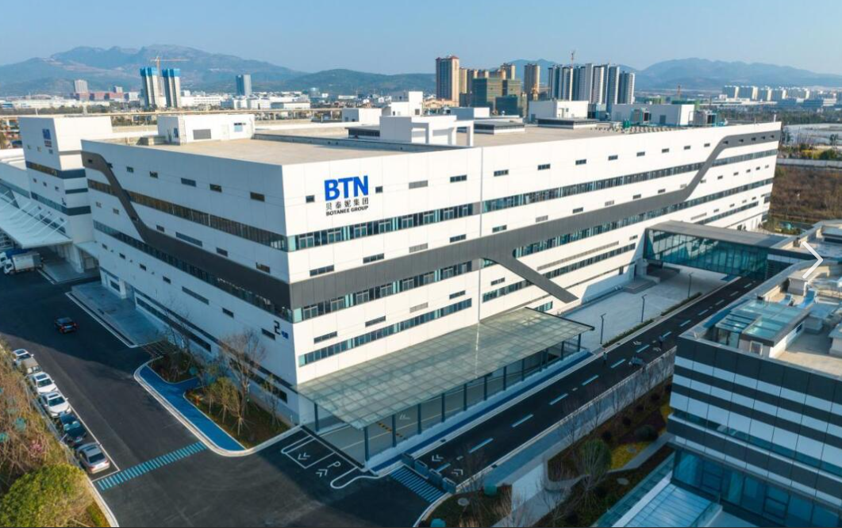
Manufacturing
Botanee Group Budget Management Digital Transformation
Customer Profile
Botanee Group (Winona parent company) leads in big health, with R&D, production, marketing, and supply chain operations. Needs digital budget management for multi-brand/business line growth.
Challenges
- Unstandardized budget data, fragmented systems, misaligned business-finance metrics.
- Manual budgeting, low inter-departmental collaboration, limited refined planning.
- Disconnected budget control, slow budget-actual analysis, lagging business response.
- Multi-division/brand coordination issues, inaccurate resource allocation.
EVOX Solution Highlights
-Multi-dimensional master data: Classified management, MDM-business system integration.
- Automated budgeting: 9 modules covered, "two-down two-up" workflow enabled.
- Flexible-rigid control: Cross-system full-node control, agile budget adjustment.
- Smart analytics: Multi-dimensional analysis + quarterly rolling forecasts for fast decisions.
Why EVOX?
EVOX tailors to Botanee’s scenarios, delivering a strategy-driven, data-powered closed-loop budget system. It breaks information silos, enabling digital transformation in the big health sector.
Benefits
Budget Preparation Efficiency Improved: Inter-departmental collaboration efficiency increased by more than 60%, significantly shortening the preparation cycle.
Master Data Quality Optimized: Standardization rate reaches 95%, significantly improving data accuracy and business adaptability.
Full Coverage of Budget Control: Achieves 100% end-to-end traceability and monitorability, reducing control risks.
Decision Response Accelerated: Resource adjustment and decision response speed increased by 3 times, enabling precise resource allocation.

